Slide 1
VietinBank proposal v6
Henry D. Lee - Sales engineer
Adelyn Le – Account executive

Slide 2
BAREMETAL

Slide 3
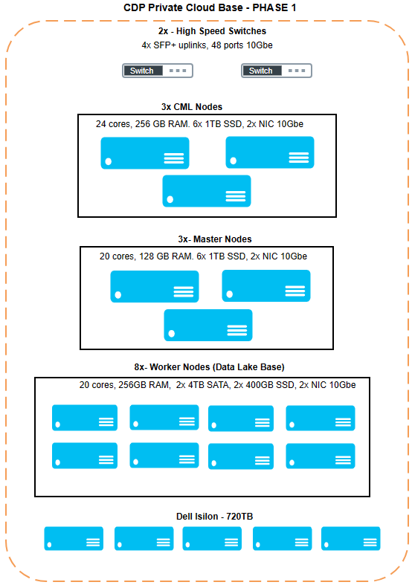
Physical aspects – PHASE 1

Slide 4
HIGH-LEVEL INVESTMENT SUMMARY
HIGH LEVEL INVESTMENT
SOFTWARE | QTY | TOTAL
(PROD) Cloudera Data Platform – PvC Base Business | 11 nodes | $110,000
(PROD) Cloudera Data Platform – PvC Base Compute (CCU) | 96 CCU | $9,600
(PROD) Cloudera Machine Learning – Dataservices | 76 CCU | $49,400
(PROD) Cloudera Data Science Workbench - CDP-DSW-10-BUS | 10 users | $50,000
(PROD) Third-Party Storage – OS3 | 720TB | $48,000
TOTAL SOFTWARE INVESTMENT |  | $
NOTES
Software Components:
Cloudera Data Platform PvC Base is the Data lake solution.
Cloudera Data Platform Compute Unit is the variable pricing when a node exceeds standard configuration (16 cores | 128 GB RAM | 48TB).
Professional Services Engagement High-level Scope:
Review Prereqs and requirements
Deployment, secure, Ingestion and Optimization
Production Implementation Plan
Documentation, KT, Inputs to long term business cases
Production Support
The above is subject for further scoping and refinement
Travel & Expenses are inclusive of the PS fees
All fees are VAT exclusive
CLOUDERA PROFESSIONAL SERVICES | DURATION | TOTAL
Cloudera PS for SMARTSTART |  | $
Travel & Expenses (Billed as incurred)
TOTAL CLOUDERA PROFESSIONAL SERVICES |  | $

